Slide 1

The Thirty-Ninth AAAI Conference on Artificial Intelligence (AAAI-25)
R-DTI: Drug Target Interaction Prediction Based on Second-Order Relevance Exploration
(1) construct a pre-trained structural feature extractor that mines the atomic relevance of each amino acid
the complex protein structures cannot be well represented by current protein sequence-based feature extractors
(2) An inter-feature structure-preserved Riemannian network is designed to expand the existing protein extraction patterns
the gap between protein and drug features increases the vulnerability of the obtained classifier thus degrading the prediction robustness
(3) develop a Riemannian classifier that uses the second-order protein-drug relevance with a unified feature space
Niu Wentao
Notes:
Hello everyone, today I will be presenting a paper published at AAAI 2025, titled: "R-DTI: Drug Target Interaction Prediction Based on Second-Order Relevance Exploration."
The main contributions of this paper are as follows:
On one hand, current protein sequence-based feature extractors struggle to capture the complex structural characteristics of proteins. To address this, the authors construct a pretrained structure-aware extractor to explore atomic-level correlations for each amino acid, and further design a Riemannian network that preserves structural relationships between features, thereby enhancing the existing protein representation framework.
On the other hand, due to the substantial gap between protein and drug features, it is challenging to design a classifier with strong generalization capability. To overcome this, the authors develop a Riemannian classifier that leverages second-order protein-drug correlations within a unified feature space.

Slide 2
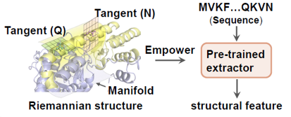


The authors use SPD matrices to construct Riemannian manifolds.
Why does the SPD matrix form a Riemannian manifold？
$$S_{++}^{n}=\{X∈R^{n×n}|X^{T}=X,x^{T}Xx>0 ∀x≠0\}$$
This set is all the symmetric positive definite matrices of $n×n$
This set satisfies the following properties:
It is an open series.
It is a smooth manifold (which can be differentiated)
Riemannian metrics can be defined, such as Affine-Invariant Metric.
Affine-Invariant Metric :
Given two SPD matrices P and Q, the distance between them is:
$$dist\left(P,Q\right)=||\log{(P^{−1/2}QP^{−1/2}){||}_{F}}$$
This distance takes into account the manifold geometry structure
Notes:
The fundamental motivation behind these improvements lies in the observation that the three-dimensional structure of a protein is inherently a non-Euclidean geometric object, which can be regarded as a manifold — specifically, a Riemannian manifold. A Riemannian manifold can be composed of multiple symmetric positive definite (SPD) matrices.

Slide 3
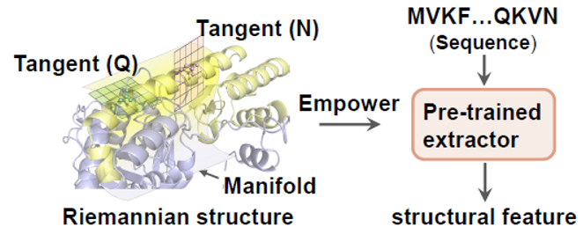
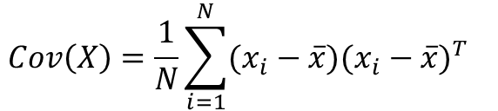


How does the author extract structural features from the sequence?
Construct the covariance matrix of amino acids vectors to emphasize the second-order correlation within a protein.
$$Cov\left(X\right)=\frac{1}{N}\sum_{i=1}^{N}{(x_{i}−\overline{x})(x_{i}−\overline{x})^{T}}$$
$x_{i}$ represents the amino acid vector
$X=\{x_{1},x_{2},…,x_{N}\}∈ℝ^{N×D}$,$Cov(X)∈ℝ^{D×D}$
Subsequently, a small identity matrix perturbation is added to transform the covariance matrix
into a symmetric positive definite (SPD) matrix.
$$Σ_{SPD}=Σ+εΙ$$
To preserve the topological relationships between amino acids within a protein, they consider amino acids distributed on the protein manifold.
Notes:
To better extract the structural features of proteins, the authors construct the covariance matrix of amino acid vectors to emphasize the second-order correlations within the protein. Subsequently, a small identity matrix perturbation is added to transform the covariance matrix into a symmetric positive definite (SPD) matrix.

Slide 4
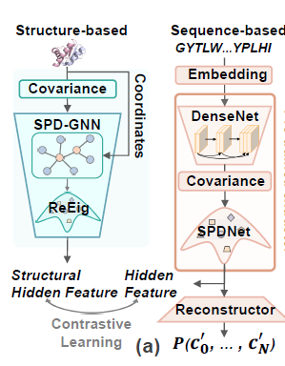
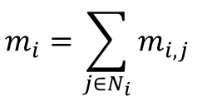

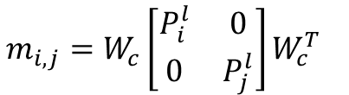
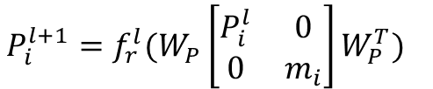
On one hand,
Vector representation of 1D embedding of proteins (B,N,128)
Calculate the covariance matrix and regularize its diagonal
Get the SPD(symmetric positive definite) matrix $P$
SPD-GNN
The update process of amino acid (node) features at each layer ($l$) is as follows:
$$m_{i,j}=W_{c}\left[\begin{matrix}P_{i}^{l} & 0 \\ 0 & P_{j}^{l}\end{matrix}\right]W_{c}^{T}$$
Get the information on the edge $m_{ij}$ from amino acid $j$ to amino acid $i$ in the layer $l$
$$m_{i}=\sum_{j∈N_{i}}{m_{i,j}}$$
Aggregate all the information of the edges with amino acid $i$ as the target node to obtain the neighbor summary representation of amino acid $i$
(The edge $m_{i,j}$ information is obtained from 3D coordinates +K-Nearest Neighbors Graph)
$$P_{i}^{l+1}=f_{r}^{l}(W_{P}\left[\begin{matrix}P_{i}^{l} & 0 \\ 0 & m_{i}\end{matrix}\right]W_{P}^{T})$$
Get the features of amino acid $i$ in the $l+1$ layer
$$Final: ℱ_{S}=\left\{P_{0},…,P_{N_{i}}\right\} [B,N,256]$$
Some eigenvalues in the covariance matrix may be very small, close to 0, which can lead to numerical instability or irreversibility.Therefore, the $f_{r}^{l}$ is used to ensure that all eigenvalues are greater than a certain positive number ε, so that the matrix is strictly positive definite and remains within the SPD manifold.
Notes:
Regarding the construction of the protein sequence feature extractor, on one hand, the authors represent a protein as a set of SPD matrices and employ an SPD-GNN to update each SPD matrix in the set, where each SPD matrix corresponds to a specific amino acid in the protein. Through these operations, the structural hidden features of the protein are effectively captured.

Slide 5


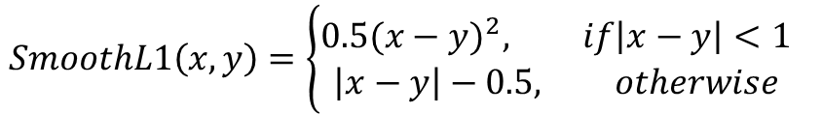






the encoding embedding of protein sequences (B,N,1024) (derived from the Prot-Bert, a protein language model)
On the other hand,
Extract text features using DenseNet
Calculate the covariance matrix and regularize its diagonal
$$ℱ_{T}=\left\{F_{0},…,F_{N_{i}}\right\} [B,N,256]$$
$$ℱ_{T}=\left\{F_{0},…,F_{N_{i}}\right\} [B,N,256]$$
$$ℱ_{S}=\left\{P_{0},…,P_{N_{i}}\right\} [B,N,256]$$
Linear, Multi-head Self-Attention, Linear
Contrastive Learning All corresponding vectors’ inner product = 1, and non-corresponding ones are 0
$$ℱ_{T_pos}=\left\{F_{0}^{pos},…,F_{N_{i}}^{pos} \right\} [B,N,3]$$
$$loss2$$
Pre-trained extractor
$$SmoothL1\left(x,y\right)=\left\{\begin{aligned}0.5(x−y)^{2}, if\left|x−y\right|<1 \\ \left|x−y\right|−0.5, otherwise\end{aligned}\right.$$
$$loss1$$
$$ℱ_{True}^{pos}=\left\{P_{0}^{pos},…,P_{N_{i}}^{pos} \right\} [B,N,3]$$
$$loss_{all}=loss1+0.1loss2$$
Notes:
On the other hand, the protein encoding is processed through a DenseNet followed by an SPD Transform to obtain the hidden feature. This hidden feature is then fed into a Reconstructor to compute the reconstruction loss (loss1) with respect to the true spatial coordinates. Additionally, contrastive learning is performed between the hidden feature and the structural hidden feature to obtain loss2. The combined loss from loss1 and loss2 is used to train the protein sequence feature extractor.

Slide 6
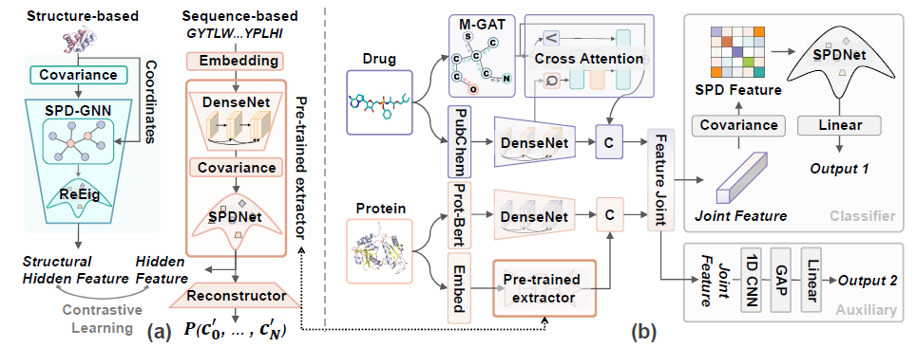




the encoding embedding from the Prot-Bert
DenseNet
$$F_{p}^{t}∈ℝ^{L_{p}×C_{t}}$$
torch.cat
$$Protein$$
$$F_{p}∈ℝ^{L_{p}×({C_{t}+C}_{s})}$$
Pre-trained extractor
the encoding embedding
DenseNet
$$F_{p}^{s}∈ℝ^{L_{p}×C_{s}}$$
the SPD matrix
Notes:
A pre-trained protein sequence feature extractor is used to extract structural information features from the protein encoding. In addition, sequence information features of the protein are obtained through Prot-Bert followed by a DenseNet. The two modalities of protein features are concatenated to obtain a more informative and comprehensive protein representation.

Slide 7






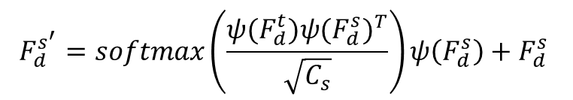




M-GAT
$$W_{a}=σ(ψ(F_{d}^{s^{l}})ψ(F_{d}^{s^{l}})^{T})$$
σ() and ψ() are the sigmoid and linear layers.
$W_{a}∈ℝ^{N_{a}×N_{a}}$ is the atomic relevance matrix
$F_{d}^{s^{l+1}}=(W_{a}∗A)ψ(F_{d}^{s^{l}})$+ $F_{d}^{s^{l}}$
Cross-Attention
$$F_{d}^{s^{′}}=softmax\left(\frac{ψ(F_{d}^{t})ψ(F_{d}^{s})^{T}}{\sqrt{C_{s}}}\right)ψ\left(F_{d}^{s}\right)+F_{d}^{s}$$
the encoding embedding from the Smiles-Bert
DenseNet
$$F_{d}^{t}∈ℝ^{L_{d}×C_{t}}$$
torch.cat
$$Drug$$
$$F_{d}∈ℝ^{L_{d}×({C_{t}+C}_{s})}$$
RDKit
Cross-Attention
Molecular Graph Attention
(M-GAT) block
$$F_{d}^{s^{′}}∈ℝ^{L_{d}×C_{s}}$$
$$atomic vectors F_{d}^{s}∈ℝ^{N_{a}×C_{s}}$$
$$adjacency matrix A∈ℝ^{N_{a}×N_{a}}$$
$$F_{d}^{s}∈ℝ^{L_{d}×C_{s}}$$
Notes:
On the other hand, the drug sequence is processed using RDKit—an open-source toolkit for cheminformatics—along with a Molecular Graph Attention block to obtain its structural information features. Additionally, the drug sequence is passed through SMILES-BERT and a DenseNet to extract its sequence information features. These two modalities of drug features are fused via a Cross-Attention mechanism and then concatenated to produce a more informative and comprehensive drug representation.

Slide 8
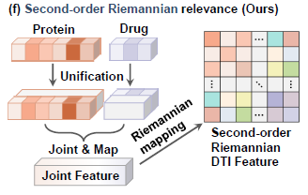

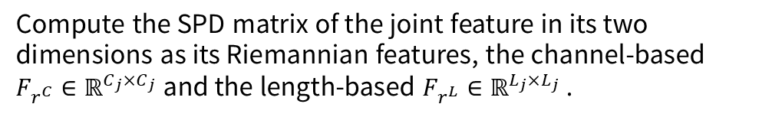
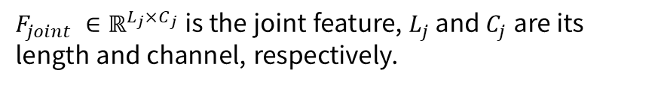
$$F_{joint}=ψ(\left[\begin{matrix}F_{p} & 0 \\ 0 & F_{d}\end{matrix}\right])$$
Compute the SPD matrix of the joint feature in its two
dimensions as its Riemannian features, the channel-based
${F_{r^{C}}∈ℝ}^{C_{j}×C_{j}}$ and the length-based ${F_{r^{L}}∈ℝ}^{L_{j}×L_{j}}$ .
ψ() is the mapping process though linear and GELU layers.
$F_{joint} ∈ℝ^{L_{j}×C_{j}}$ is the joint feature, $L_{j}$ and $C_{j}$ are its length and channel, respectively.
The Riemannian features are compressed using SPDNet and converted into vectors, and then MLP are used to predict DTI.
Notes:
The authors map the previously obtained protein features and drug features through fully connected layers to obtain a joint feature. Subsequently, an SPD matrix is computed from the joint feature to serve as its Riemannian representation. Finally, the Riemannian feature is transformed into a vector representation, and an MLP is employed to predict the interaction between the protein and the drug.

Slide 9
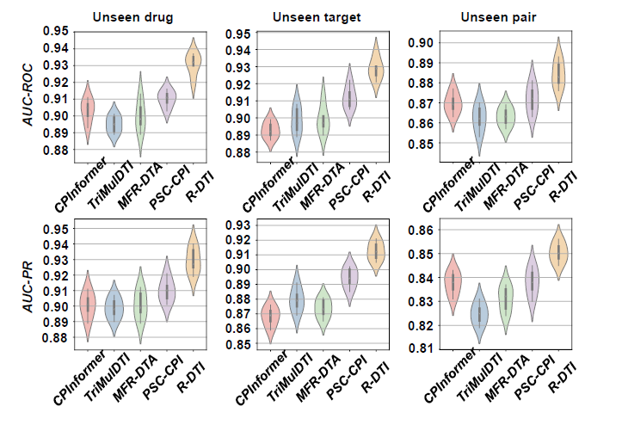
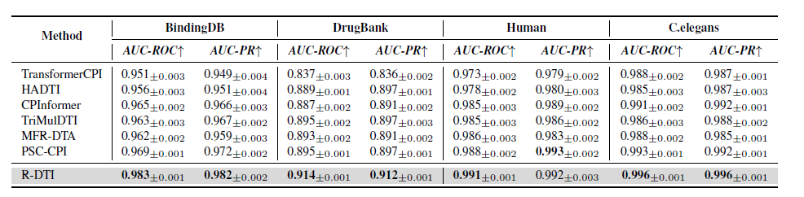
Notes:
The authors find that most of these methods perform worse in the Unseen target subset than in the Unseen drug subset, indicating that their learned parameters are biased towards the proteins to some extent. However, R-DTI using Riemannian SPD features, which is the covariance matrix of the joint protein and drug features, can effectively improve its generalization in the Unseen target subset. AUC-ROC is used to evaluate the overall ability of a model to distinguish between positive and negative classes, with higher values indicating stronger discriminative capability. AUC-PR reflects the model's combined performance in terms of precision and recall, with higher values indicating better identification of positive samples while minimizing false positives.
As shown in the table above, the proposed R-DTI method outperforms all other methods across most evaluation metrics, particularly on the BindingDB and DrugBank datasets. Specifically, R-DTI achieves performance gains of 1.4% and 1.0% in terms of AUC-ROC and AUC-PR, respectively, compared to the second-best method, PSC-CPI, on the BindingDB dataset. Similarly, on the DrugBank dataset, R-DTI surpasses PSC-CPI by 1.9% in AUC-ROC and 1.5% in AUC-PR, demonstrating the superior effectiveness of the proposed method. On small-sample datasets such as Human and C. elegans, the R-DTI model also maintains consistently strong performance.

Slide 10
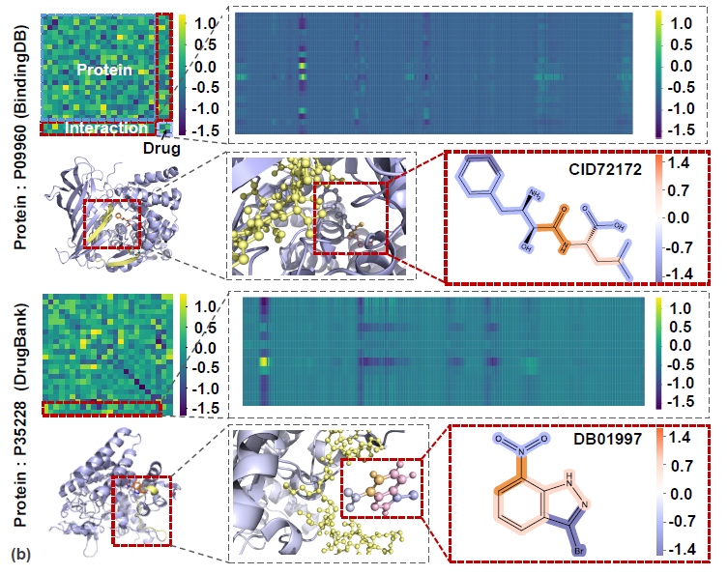
Notes:
Based on the length-based Riemannian feature, the authors visualize two pairs of samples from BindingDB and Drug-Bank
It is easy to observe the interactive degree between the amino acids in the protein and the atoms in the drug by visualizing the length-based Riemannian feature
On this basis, they visualize the structure of the protein and the drug, highlighting their high response regions in yellow and orange, respectively.

Slide 11
Thank you

Slide 12

SPD Transform
feature extraction
$$P^{′}=WPW^{T}$$
Ensure that the output is still the SPD matrix (because the transformation maintains symmetry and positivity)
In Euclidean space, MLP is a linear layer + activation;
In the SPD manifold, (SPD Transform)*n is a continuous Riemannian transformation.
Notes:
保证输出仍是 SPD 矩阵（因为变换保持对称性和正定性） 特征变换：在欧几里得空间中 MLP 是线性层 + 激活； 在 SPD 流形中，(SPD Transform)*n 是连续的黎曼变换。
氨基酸(节点)特征在每一层的更新方式如下:
获取第l层，氨基酸j到氨基酸i的边mij上的信息 聚合以氨基酸i为目标节点的边的所有信息，以获得氨基酸i的邻居汇总表示
获取第L+1层，氨基酸i的特征， 协方差矩阵中的某些特征值可能非常小，接近 0，会导致数值不稳定或不可逆。因此，$f_{r}^{l}$ 层用于保证所有特征值大于某个正数 ε，
使得矩阵严格正定，保持在 SPD 流形内。

